Slide 1
Shaking Penguins & Boxes at LHCb
Lyon, le 30 Octobre 2013
Yasmine Amhis
LAL, Orsay France
If you have questions : amhis@lal.in2p3.fr

Slide 2
Sometimes this is how a flavour physics talk in a conference sounds like…

Slide 3
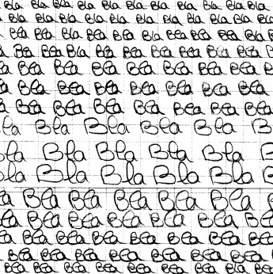

Slide 4
Le Questionnaire de Proust
What is the Process ?
A tree, a penguin ?
What is the observable ?
What does it probe ?
SM, NP, QCD ?
What is the statistics?
Is it a rare decay ?
What is the topology ?
Are you ever going to see it?
What about the systematics?
Do we really care about it ?

Slide 5
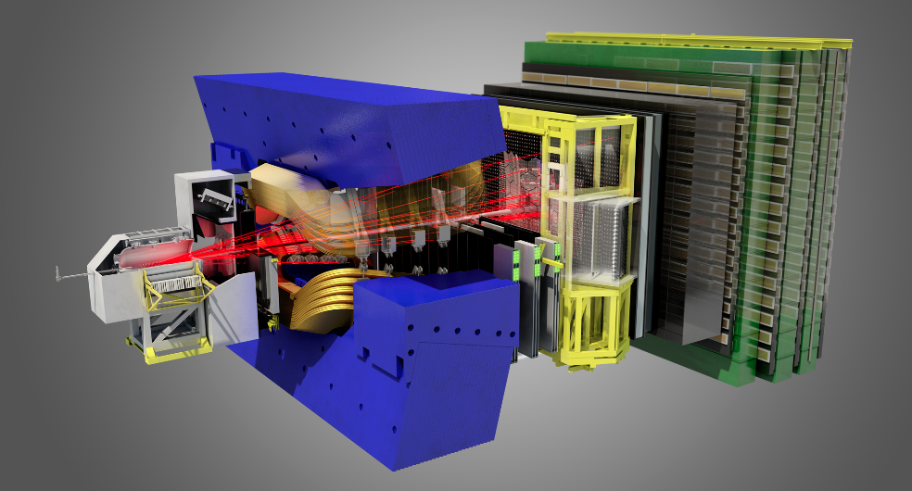
Let’s start shaking things
Apologies, I won’t have time to discuss the other experiments….

Slide 6
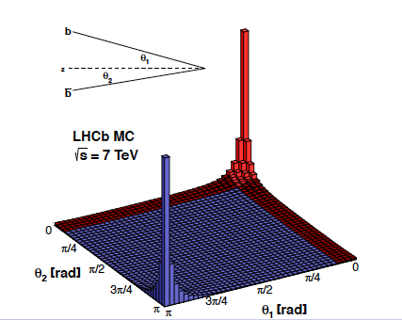
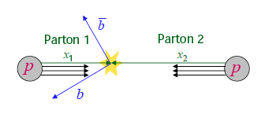
LHC a Flavour Factory
Large cross sections @ 7 TeV :
  σ^{inel}_{pp} ~ 60 mb [JINST 7 (2012) P01010
  σ^{inel} (pp → charm) ~ 6 mb [LHCb-CONF-2010-013]
  σ^{inel} (pp → beauty ) ~ 0.3 mb [PLB 694 (2010) 209]
In high energy collisions, bb/cc pairs
are produced predominantly in
the forward or backward directions
Initial motivation for the design

Slide 7
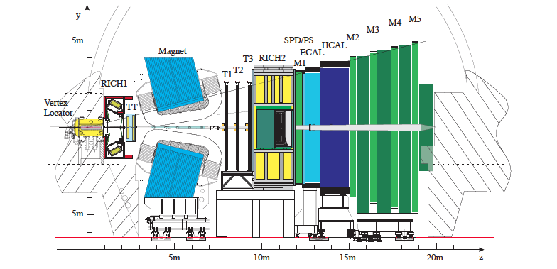
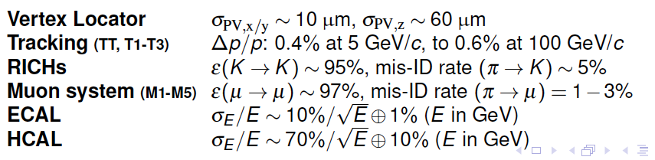
The LHCb detector

Slide 8
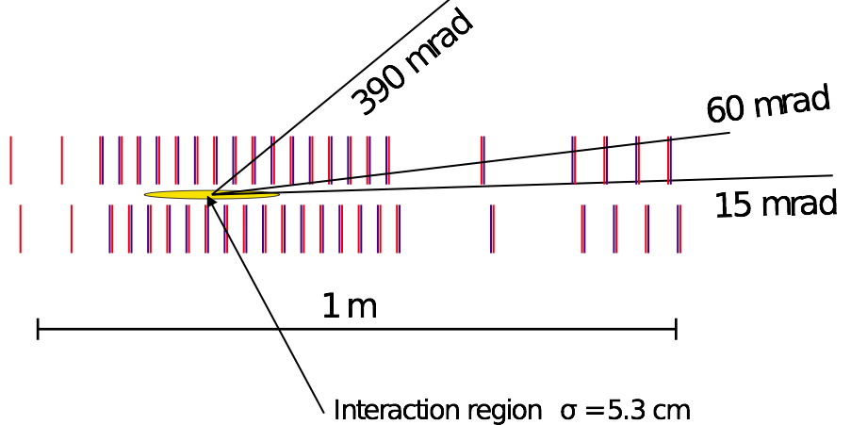
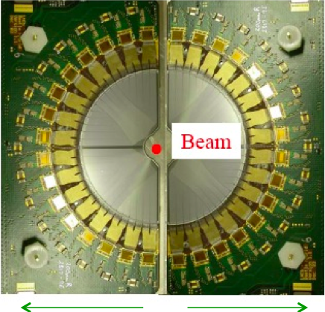
Tracking
Proper time measurement :
  Identify b-hadrons (cτ ~ 450 μm) , also in the trigger
  Perform time dependent analyses.
VELO
21 modules r-φ sensors
Invariant mass measurement :
  Identify the signal (B_{d} and B_{s} are only 90 MeV apart)
  Separate signal from background
active zone : 8mm from the LHC beam : retractable
Δp/p ~ 0.4 %

Slide 9
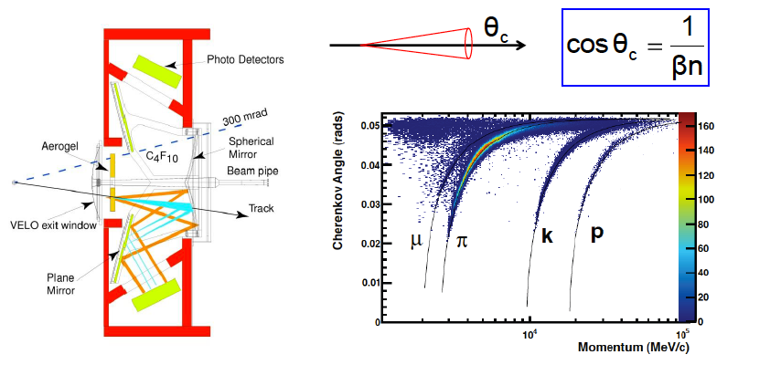
Particle ID
9

Slide 10
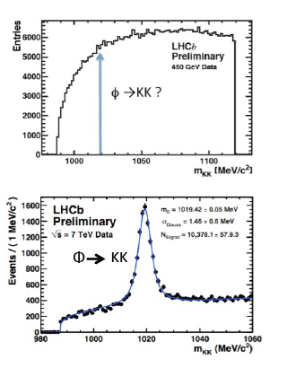
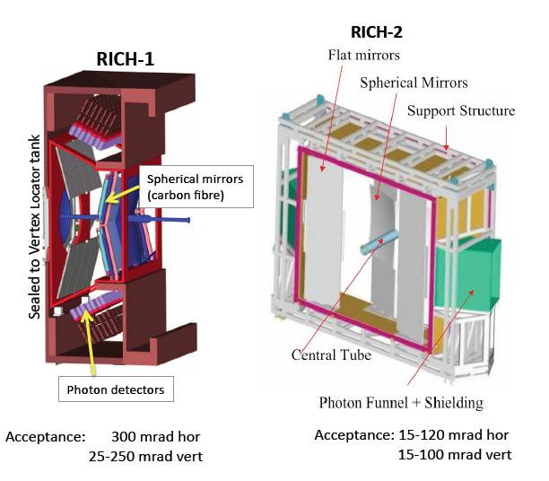
Particle ID
10

Slide 11
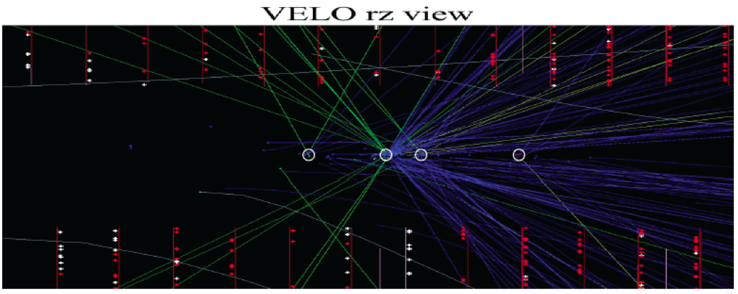
Working with pile up
 | Energy | Bunch spacing | Average number of visible interaction per bunch crossing | Luminosity
Design | 14 TeV | 25 ns | 0.4 | 2 10³² cm⁻² s⁻¹
2011 | 7 TeV (σ^{14TeV}_{bb} /2) | 50 ns | 1.4 | 3.5 10³² cm⁻² s⁻¹
2012 | 8 TeV (σ^{7TeV}_{bb} x 1.15 ) | 50 ns | 1.6 | 4. 10³² cm⁻² s⁻¹

Slide 12

LHCb detectors efficiency

Slide 13
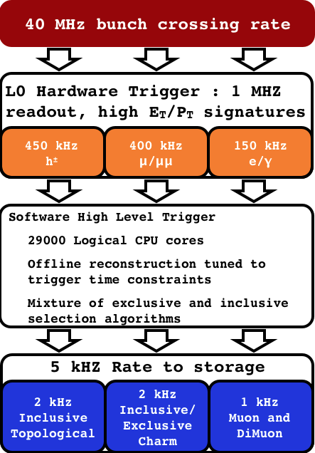
Trigger System in 2012
1/200 events contain B hadrons → we have to select only these!
Hardware: High PT signals in calo and muon systems
Software: partial reconstruction
Software: global reconstruction (very close to offline)
 | Charm | Hadr. B | Muonic B
Global efficiency | ~10% | ~ 20% | ~80%

Slide 14
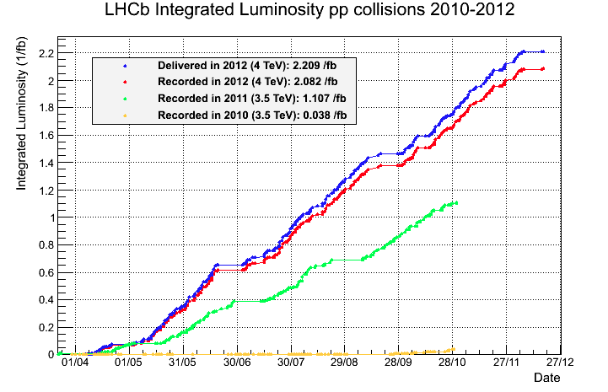
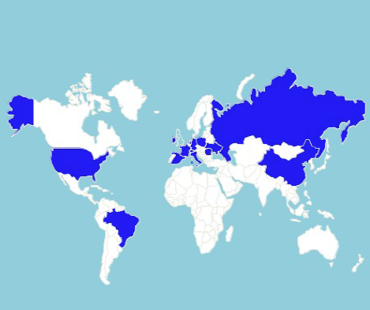
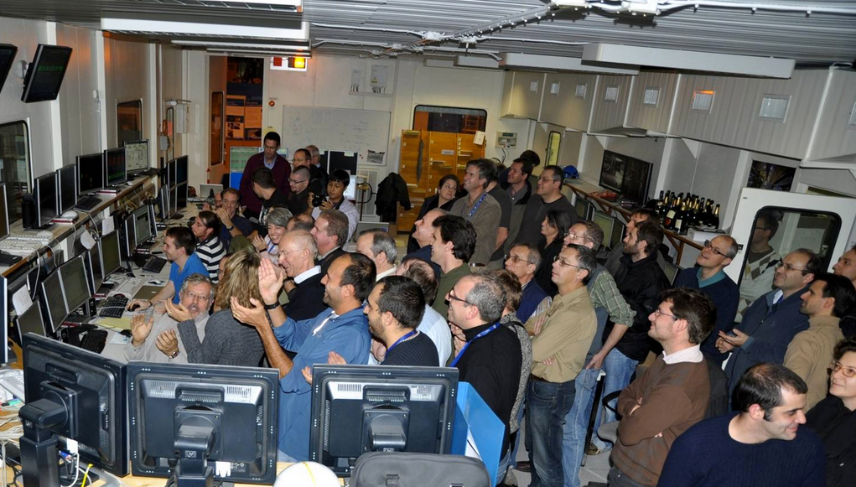
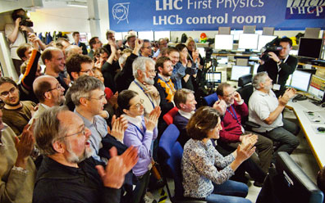
LHCb 600 people

Slide 15
Indirect Searches – Model Independent Searches
Four examples of how to look for New Physics
How can New Physics affect a frequency?
How can New Physics affect a phase ?
How can New Physics enhance a suppressed decay ?
How can New Physics affect angular observables ?

Slide 16

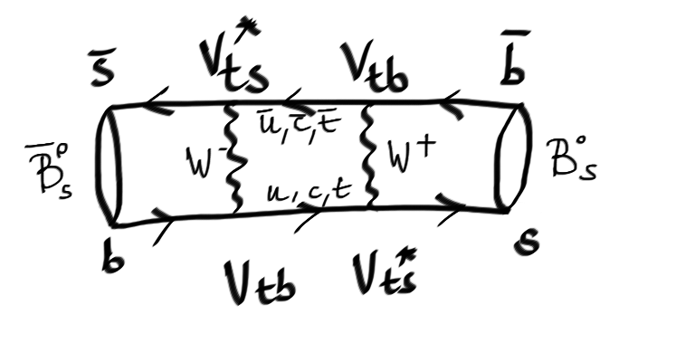
Boxe diagram
Neutral B_{s} meson

Slide 17
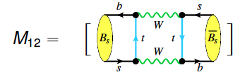
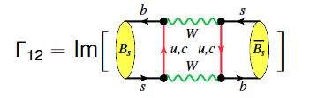
Boxe diagram
Neutral B_{s} meson

Slide 18
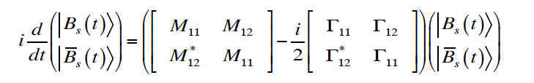
Boxe diagrams
Neutral B_{s} meson
Time Evolution :
Diagonalizing this Hamiltonian leads to two mass
eigenstates with masses M_{H(L)} and decay width Γ_{H(L)}

Slide 19
The B⁰_{(s)} neutral system
Time Evolution
Δm_{s} = M_{H} – M_{L}, ΔΓ_{s} = Γ_{H} – Γ _{L}, Γ_{s} = (Γ_{L}+Γ_{H})/2

Slide 20
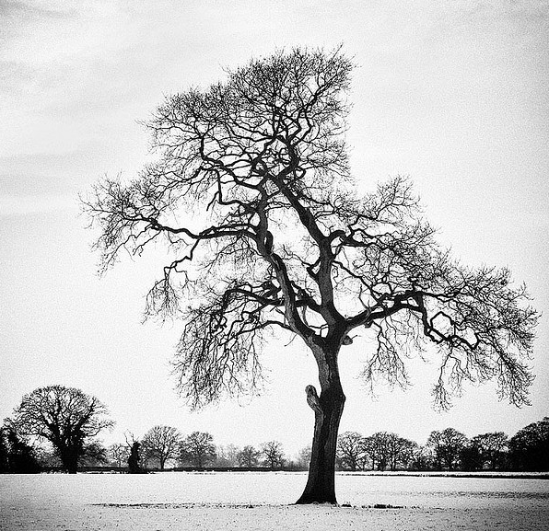
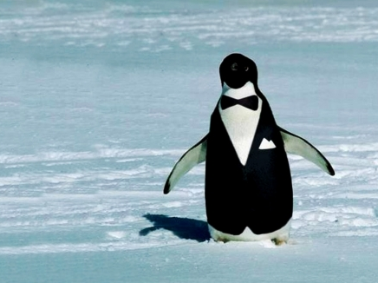
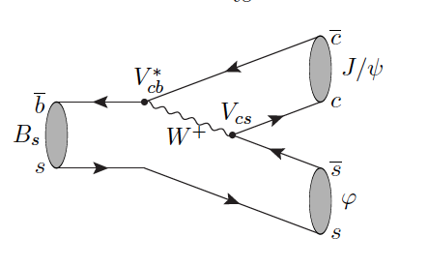
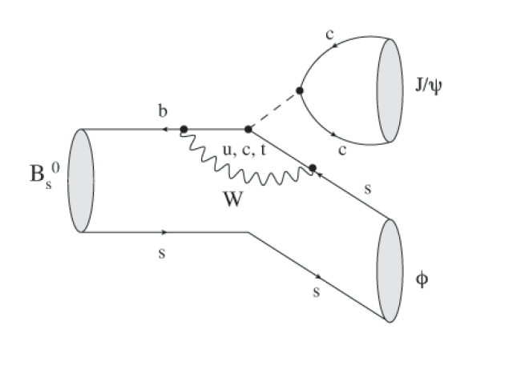
Color Suppressed Tree & Penguin(s)
When the B_{s} decays…

Slide 21
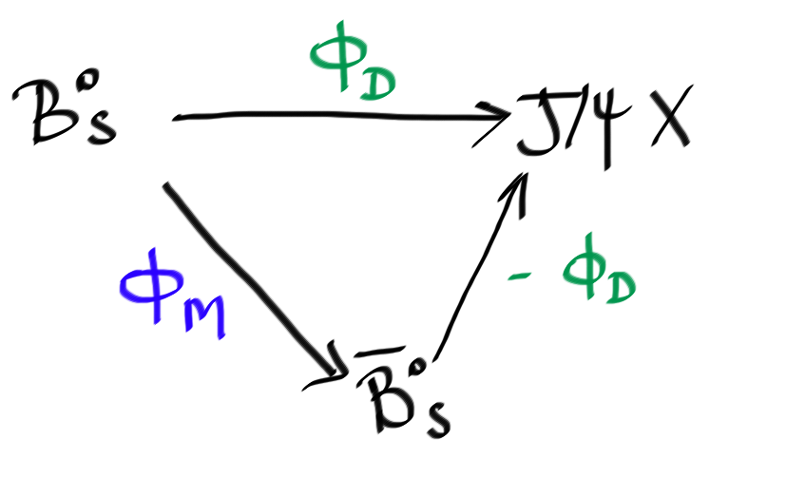
Phases phases
Measure relative phase difference
ϕ_{s}= ϕ_{M} − 2ϕ_{D} between two “legs/paths/routes”.
In SM + Ignoring penguins
ϕ_{D} ~ 0
ϕ_{s}SM ~ ϕ_{M}
  is predominantly determined by arg(V_{ts} )
  is predicted to be small ~ -0.04
  [Charles et al. Phys. Rev. D84 (2011) 033005]
New Physics (NP) can add large phases:
ϕ_{s} = ϕ_{s}SM + ϕ_{s}^{NP}

Slide 22
Theoretically :
b→ccs tree dominance leads to precise prediction of ϕ_{s} in SM.
SP → VV, admixture of CP-odd and CP-even states, measure also ΔΓ_{s}.
Experimentally :
Relatively large branching ratio.
Easy to trigger on muons from J/ψ → μ⁺μ⁻.
The Observables
3 “P-wave” amplitudes of KK system ( A₀, A_{perp}, A_{para})
1 “S-wave” amplitude (A_{s})
10 terms with all the interferences (see the next slide)
ϕ_{s} , ΔΓ_{s,} , Γ_{s} …

Slide 23
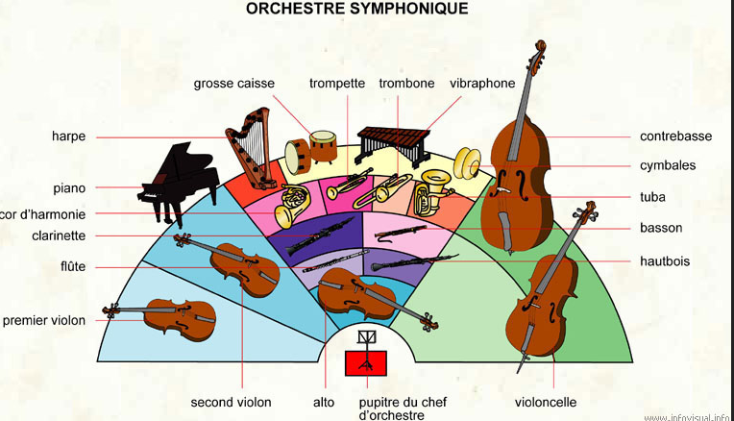
How we work together ?

Slide 24
How we work together ?
Mass
Time
Flavour Tagging
Angles

Slide 25
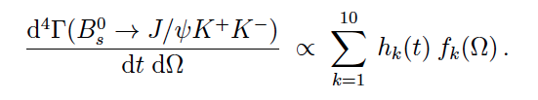
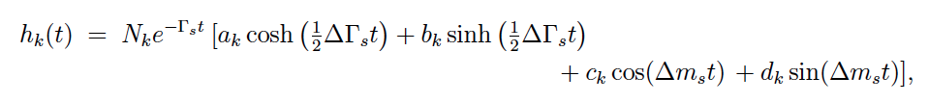
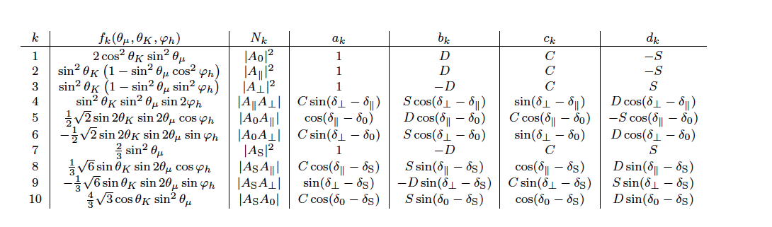




A few more words
Time dependent
Angular terms

Slide 26
A few more words
Time dependent
Angular terms

Slide 27
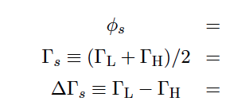
La Sainte Trinité du jour
ϕ_{s}
ΔΓ_{s}
Γ_{s}

Slide 28


Slide 29
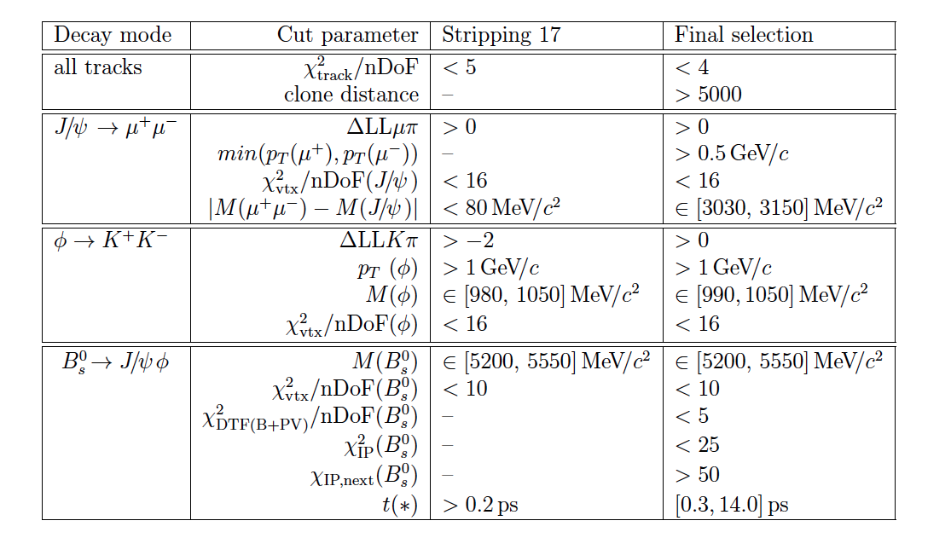
Event selection
Simple cut based selection kinematics + particle identification
Attempts to use MVA, but no significant improvement was observed

Slide 30
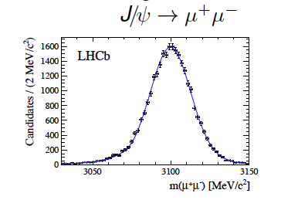
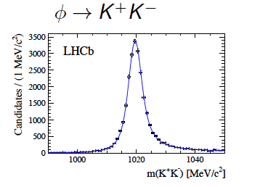
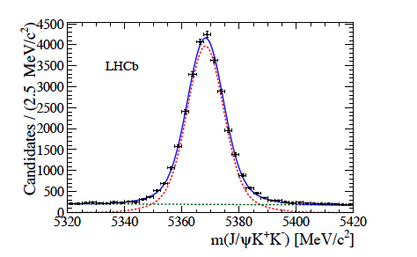
Selection Results
About 28 000 signal events
with very high purity !

Slide 31
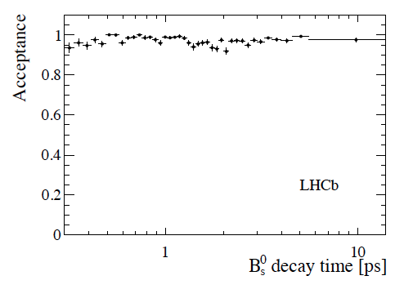
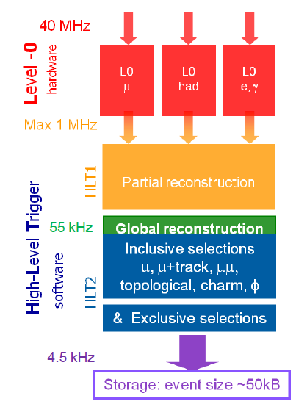
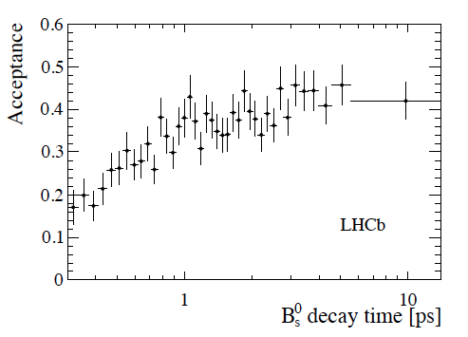
Trigger Acceptance^{(*)}
“Unbiased”
“Very biased”
^{(*)} C’est quand même une machine hadronique !

Slide 32
Mode acceptances on the decay time
Corrections needed:
Track Reconstruction
Online and Offline
Vertexing
φ and PV
Total systematic error on the lifetime is 8.7 fs .
Main effect due to the track reconstruction in the Velo.
Partly due to the limited size of the control sample.

Slide 33
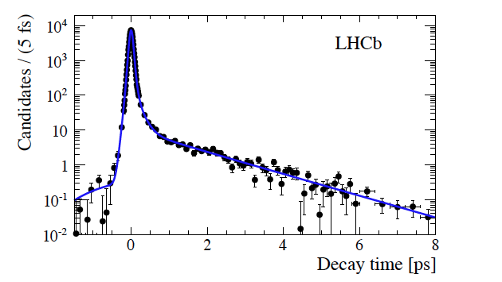
Decay time resolution
sWeights extracted
from J/ψ mass
sWeights extracted from J/ψ mass fit
We measure from data using prompt J/ψ which decay at
t = 0 ps triggered with the unbiased triggers.
Model is a triple Gaussian.
Width is found to be about 45 fs.

Slide 34
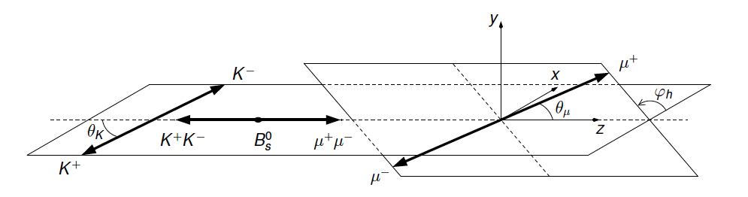
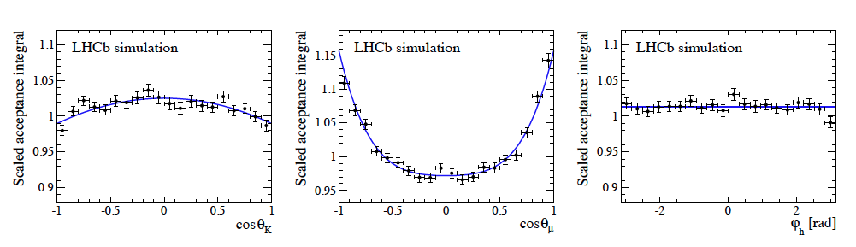
Angles and their acceptances
Forward geometry of LHCb + selections cuts :
distorted angular acceptance Determined using MC

Slide 35
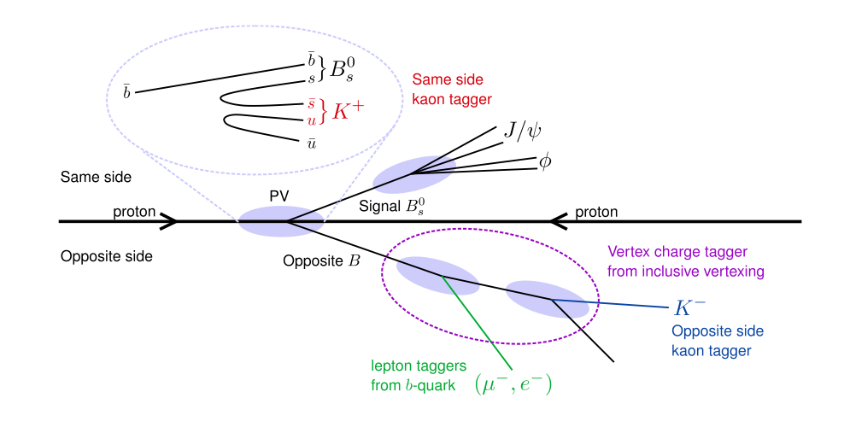
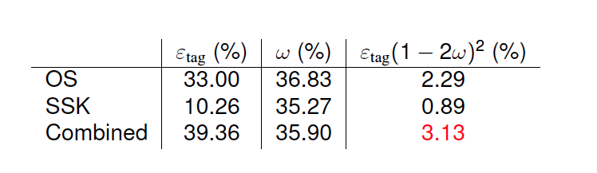
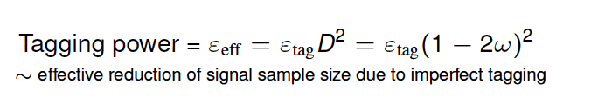
Flavour Tagging
Time dependent CP asymmetry needs to identify the initial flavour of reconstructed B_{s}⁰ mesons (initial state a b or b quark).
Compare this to e⁺e⁻ colliders: eD² ~ 30%

Slide 36
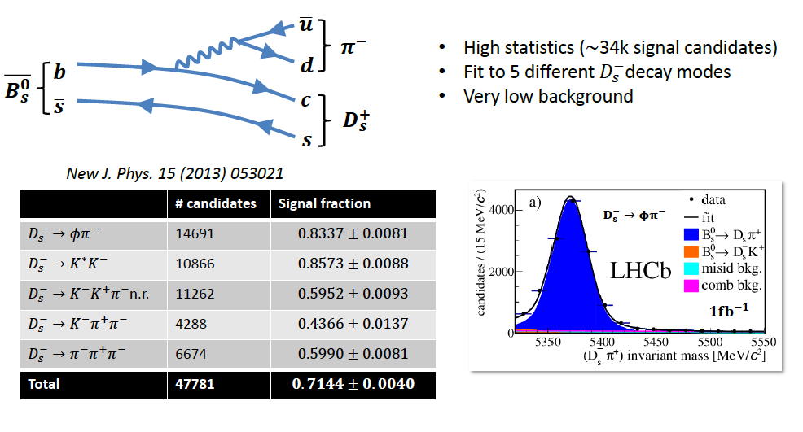
Δm_{s} from B_{s} → D_{s} π⁺
Very high statistics
Low background level
Can resolve B_{s} mixing frequency due to high boost
Use flavour tagging to determine flavour at production,
pion charge for flavour at decay

Slide 37
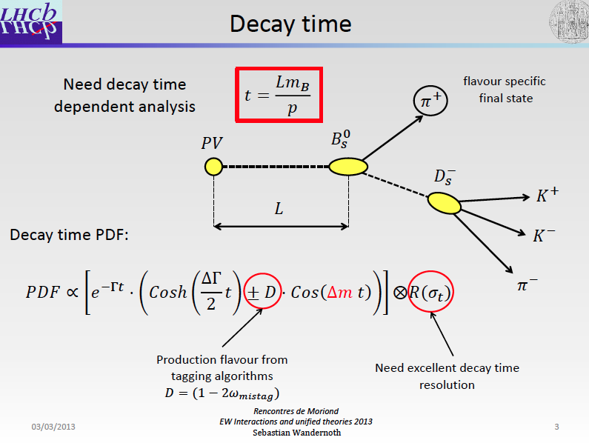

Slide 38
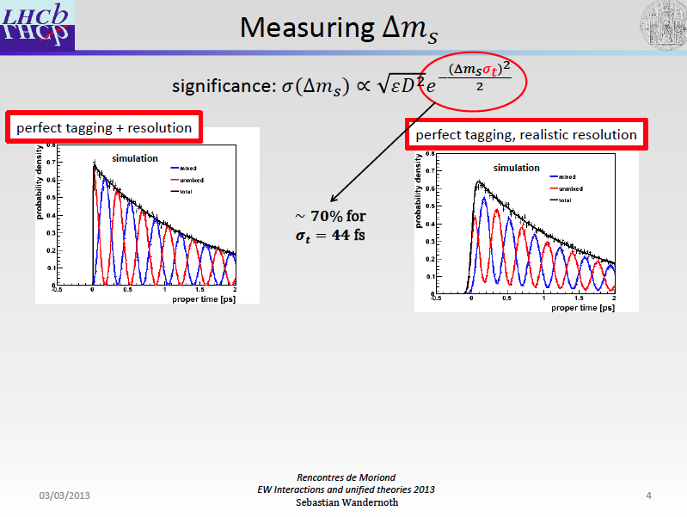

Slide 39
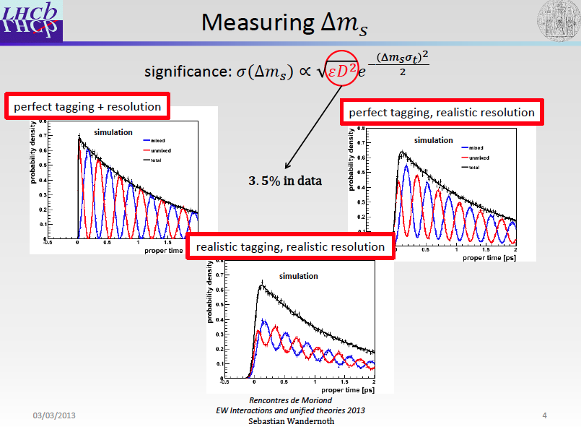

Slide 40
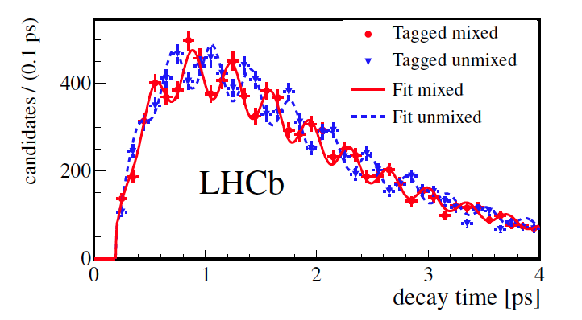
Δm_{s} from B_{s} → D_{s} π⁺

Slide 41

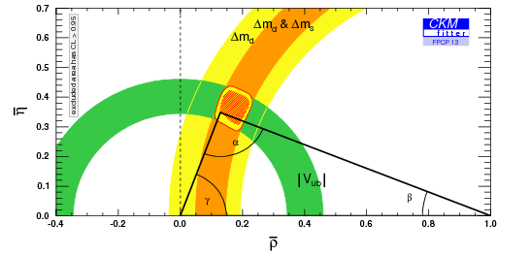
How can New Physics affect a Phase?
CKM Elements
QCD corrections
Input from Lattice
Short Distance Contributions

Slide 42


Revenons à nos moutons

Slide 43

Sticking all the pieces together Results I

Slide 44



Sticking all the pieces together Results II
ΔΓ_{s} > 0 and Φ_{s} compatible with SM – oh well !

Slide 45

Putting it all together

Slide 46

The Event !
Example of a blind analysis

Slide 47
A very rare FCNC
b
μ
?
s
μ

Slide 48


A very rare FCNC
b
μ
?
s
μ

Slide 49
How do we measure a BR ?
Number of observed decay
Efficiency
Integrated luminosity
bb cross section
Fraction of b quarks that hadronize into a Bs
Have large systematic errors

Slide 50
How do we measure a BR ?
The trick is to normalize with respect to another decay with a very well known BR:
Most of systematic uncertainties cancel in the ratio of efficiency
This cancellation is very efficient if you have a normalization channel similar to your signal and selected in the same way!

Slide 51
The Master Plan
Selection
  Oppositely charged muons making a good vertex separated from the PV with m_{µµ} in the range [4.9-6] GeV/c²
  Loose cut on a MVA discriminant
  Similar to control channels (B_{d/s} → h⁺h⁻, B⁺→J/ψK⁺)

Slide 52
The Master Plan
Selection
  Oppositely charged muons making a good vertex separated from the PV with m_{µµ} in the range [4.9-6] GeV/c²
  Loose cut on a MVA discriminant
  Similar to control channels (B_{d/s} → h⁺h⁻, B⁺→J/ψK⁺)
Signal and background discrimination:
  Boosted decision tree combining kinematic and geometrical properties
  Invariant mass
  Data driven calibration through control channels

Slide 53
The Master Plan
Selection
  Oppositely charged muons making a good vertex separated from the PV with m_{µµ} in the range [4.9-6] GeV/c²
  Loose cut on a MVA discriminant
  Similar to control channels (B_{d/s} → h⁺h⁻, B⁺→J/ψK⁺)
Signal and background discrimination:
  Boosted decision tree combining kinematic and geometrical properties
  Invariant mass
  Data driven calibration through control channels
Normalization using B⁺ → J/ψK⁺ and B_{d} → Kπ

Slide 54
The Master Plan
Selection
  Oppositely charged muons making a good vertex separated from the PV with m_{µµ} in the range [4.9-6] GeV/c²
  Loose cut on a MVA discriminant
  Similar to control channels (B_{d/s} → h⁺h⁻, B⁺→J/ψK⁺)
Signal and background discrimination:
  Boosted decision tree combining kinematic and geometrical properties
  Invariant mass
  Data driven calibration through control channels
Normalization using B⁺ → J/ψK⁺ and B_{d} → Kπ
Background estimation
  Combinatorial from m_{µµ} sidebands
  Double misidentified B_{d/s} → h⁺h⁻ (h=K,π)
  Detailed study on various exclusive background

Slide 55


Mass resolution calibration
Interpolation

Slide 56



Selection
Main background: combinatorial from bb→μ⁺μ⁻X
Signal PDF calibrated with B_{(s)}→ h⁺h’⁻
Contribution in signal window only B_{(s)}→h⁺h’⁻
Exclusive background parameters used
as priors in the fit (allowed to vary within 1σ)

Slide 57


Before unblinding
2012 (Up) + 2011 (Bottom)

Slide 58



Branching ratio fit
2011
7 TeV data, 1.0 fb⁻¹
8 BDT bins
2012
8 TeV data, 1.1 fb⁻¹
7 BDT bins

Slide 59


Voilà !
B⁰ → π⁻µ⁺ν
B_{s} → K⁻µ⁺ν
B ^{0/+}→ π^{0/+}µµ
B_{d/s} → h⁺h’⁻
B_{s}→μ⁺μ⁻
B⁰→μ⁺μ⁻
Total

Slide 60

“La patience est amère mais son fruit est doux”

Slide 61

An other less rare FCNC

Slide 62

SM :
Interferences between all these diagrams: a large number of observables
System described by
  q² =M²(ℓℓ)
  3 angles
Ф
K⁻
μ⁻
θ_{ℓ}
θ_{K}
B
Right handed part
(suppressed in SM)
μ⁺
π⁺
C_{i} : short distance Wilson coefficient (pert. )
O_{i} : long distance operator (non-pert.)
62

Slide 63
As for the measurement of Φ_{s} , the full description is complicated :
Ф
K
ℓ⁻
θ_{K}
θ_{ℓ}
B
ℓ⁺
π
The C^{(’)}_{7..10} are encoded in the I_{i=1,..9}

Slide 64
B_{s}→J/ΨKK
28000 signal events
B_{d}→K*μμ
900 signal events
B_{d}→K*μμ
900 signal events
Some tricks have to be found !
Ф transformation:
if Ф < 0 then Ф = Ф+π : keeps cos (2Ф) and sin (2Ф) effects cancels cos(Ф) and sin(Ф) effects (including acceptance effects) !

Slide 65

The Spectrum
B_{d}→K*μμ
900 signal events
B_{s}→J/ΨKK
28000 signal events

Slide 66
Four parameters to fit (F_{L}, A_{FB}, A_{T}² and A_{T}^{Im} ) in bins of q²

Slide 67

Four parameters to fit (F_{L}, A_{FB}, A_{T}² and A_{T}^{Im} ) in bins of q²
F_{L} is the fraction of longitudinal polarization
A_{FB} is the lepton Forward Backward asymmetry
The q² value at which A_{FB}=0 is a sensitive probe to New Physics

Slide 68

Fit to the data

Slide 69



Fit to the data

Slide 70

More fits to the data !

Slide 71


3.7 σ tension. What is happening here :
- A fluctuation ?
How reliable is the theoretical prediction ?
Is it a sign of New Physics ?
Boh ! we have to understand what is happening.

Slide 72

Zupan

Slide 73

Zupan

Slide 74

Conclusions
If New Physics is playing Hide and Go Seek with us, then it’s really playing well !
This being said, LHCb is the ideal seeker to look for New Physics in boxes and loops !
Thank you for your attention !
Merci à Justine,M.-H, Johannes, Pete mais aussi Stéphane & Stéphane.

Slide 75
Main references
arXiv:1308.1707
arXiv:1307.5024
arXiv:1304.2600

Slide 76


Slide 77

Systematiques

Slide 78




Semileptonic asymmetries
The observales :
How we measure it :
Yields 190 k B_{s}⁰ candidates in 1.0 fb⁻¹:
LHCb-CONF-2012-022
D_{s}⁺
D_{s}⁻

Slide 79


Semileptonic asymmetries
Delicate systematic treatement is needed :
  Obtain any corrections from data/control samples.
  Pay attention to the π and μ detection asymmetries.
  Swap magnetic field to help cancel effects.
LHCb-CONF-2012-022

Slide 80

Semileptonic asymmetries
Not latest D0 result
We measure :
a_{sl} ^{s} = (-0.24 ± 0.54 ± 0.33 ) %
Most precise measurement !
And also in agreement with SM
as quoted in arXiv:1205.1444
a_{sl} ^{s} = (0.0019 ± 0.0003 ) % and
a_{sl} ^{d} = (-0.0041 ± 0.0006 ) %
LHCb-CONF-2012-022
Dominant systematic is from limited statistics in control sample.
3 tension with SM in the D0 result, not confirmed or excluded by LHCb.
More decay modes, data are needed. But also the B⁰ mode!

Slide 81


We are now entering in the era of constraining Wilson’s coefficients !
Many preprints out in the last months on this subject (arXiv:1209.0262, arXiv:1206.1502 …)
BR(B→X_{s}γ)
B→X_{s}ll
B→K*μμ
B_{s}→μμ
A_{CP}(b →sγ)
B →Kμμ
A_{CP}(B→K*π⁰γ)
arXiv:1206.0273v2
Combined
SM
Large bins in q² still used (eg 1-6 GeV²)
More statistics and finer binning : larger sensitivity

Slide 82

How do we make the fit to the data ?
Use the mass fit to extract sWeights → Need to model “only the signal component”.
Split the data in 6 bins of m_{KK} → increase sensitivity
K⁺K⁻ P-wave :
Phase of Breit-Wigner amplitude
increases rapidly across φ(1020)
mass region
K⁺K⁻ S-wave:
Phase of Flatté amplitude for f0(980)
relatively flat (similar for non-resonance)
“Pheno” work
Phase difference between S- and P-wave amplitudes
Decreases rapidly across φ(1020) mass region

Slide 83




To improve the precision
Combining with the J/Ψππ channel

Slide 84

B_{s/d}→μ⁺μ⁻
Excellent momentum and IP resolution:
  δp/p ~0.4% to 0.6% for p=5-100 GeV/c
  σ(IP) = 25 μm @ 2GeV/c
Excellent muon identification:
  Use muon chambers information + global PID likelihood (RICH, CALO, MUON).
  ε(µ → µ)~98%, ε(π → µ)~0.6%, ε(K → µ)~0.4%, ε(p → µ)~0.3%

Slide 85


Slide 86


